Slide 1
The Modern Atomic Bomb
by Christopher Dungo and Alfred Lam

Slide 2
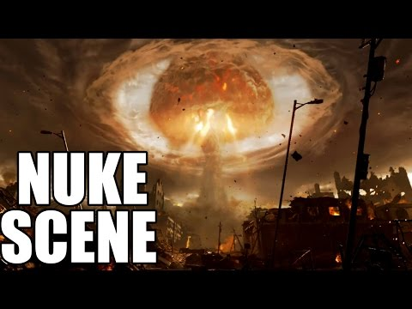
What kind of effect are we going for?

Slide 3


Blinding Light
implemented with Unity’s Lens Flare Component
can be similar to the Bloom effect

Slide 4
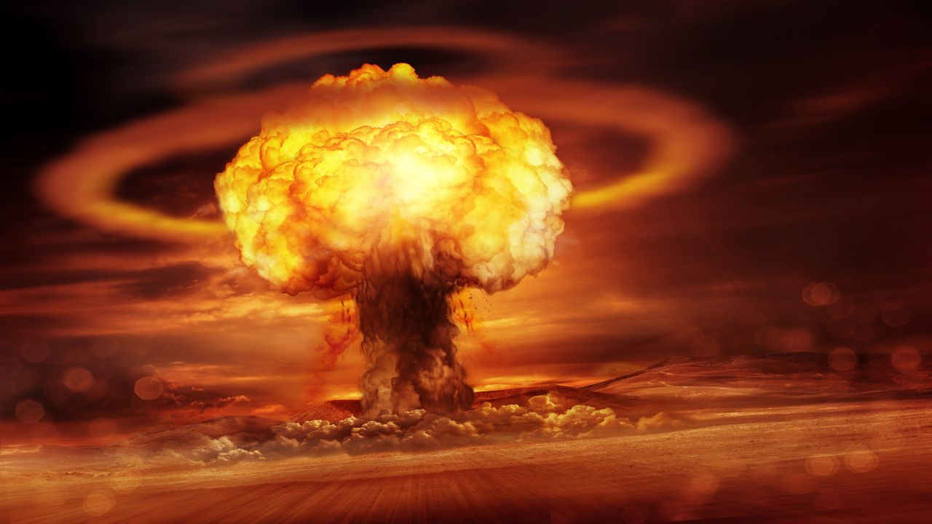
Smoke Effects
Particle Systems, who knew?
One for the “mushroom”
One for the “ring”
High emission rates
Texture Sheets
Less particles to generate, especially for sub-emitters
Animated
Unity’s Anim Alpha Blended shader

Slide 5

Fiery Center of Explosion
Particle systems, similar to smoke particles

